Slide 1
EE 205: Lecture 1, Introduction
Data Structure and Algorithms
for Electrical Engineering
Yung Yi

Slide 2
Instructor
Yung Yi (이융)
N1, 810
http://lanada.kaist.ac.kr, yiyung@kaist.edu
LANADA: LeArning in Networking: Algorithm, Design, and Analysis
Office Hours
To be announced later

Slide 3
TAs
6 Excellent TAs
Wan Ju Kang
Joonki Hong
Kyunghwan Son
Jihwan Bang
Taeyoung Lee
Hoyong Choi
They will be with us to help you.

Slide 4
Course Homepage
KLMS
http://klms.kaist.ac.kr/
To download course materials
To submit your assignments
To check your score on each assignment
Classum
To ask questions about everything
We will let you know the code that you can use later

Slide 5
Textbook
Goodrich and Tamassia,
Data structures and Algorithms in C++ (2nd edition)

Slide 6
Grading
4 Programming Assignments
In-class quiz and written homework assignments
Midterm and final exams
Class participation
Grading portions (Strict)
A(40%), B(30%), C(20%), D(10%), F …

Slide 7
Two Groups
Group A
Students
Who take this course first time
Who did not take any course on data structure in other departments
Who took the data structure course in other departments, but its grade is equal to and below `C-’
Who took this course, but retakes it again
Group B
Other students
Grading will be made in each group

Slide 8
Late Policy & Attendance Check
All written assignments should be submitted at the beginning of each class.
Any work received after that time is given 0 credits.
Programming Assignments
Deducted x% for each day being late.
Attendance check
Mostly, at the beginning of each class (taking photos for the attendance check)
Often, in the middle of or at the end of each class

Slide 9
Programming Language and Platform
C++ and Linux
Video lectures about C++ in KLMS
Please watch and study them as soon as possible
Where to do programming
Haedong Lounge, E3-4 #1412
https://ee.kaist.ac.kr/en/node/15084?language=en
IDs will be created
Please finish registering the class as soon as possible

Slide 10
What You Should NOT Do

Slide 11
How to Communicate
Most should be via Classum
Technical questions about lectures, homework, and etc
DO NOT
Individually send emails to Prof. Yung Yi and TAs (or making calls or sending Kakaotalk msgs) about the technical questions (course contents, homework etc)
All the questions need to be shared among the students
DO NOT POST a chunk of source codes. TAs are not debuggers. We cannot fix your bugs and we don't want to parse through your code to find the bugs.
But, you can send an email to Prof. Yung Yi for the things that need to be individually discussed

Slide 12
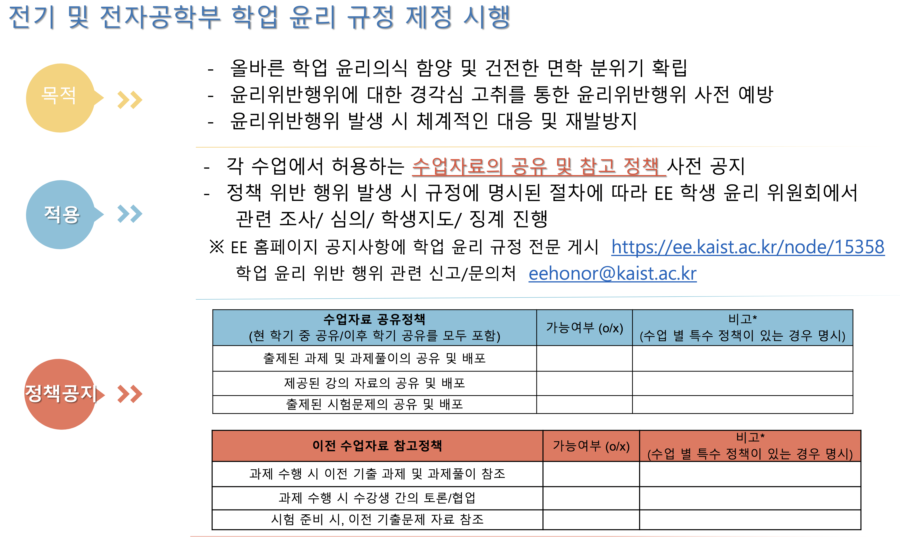

Slide 13
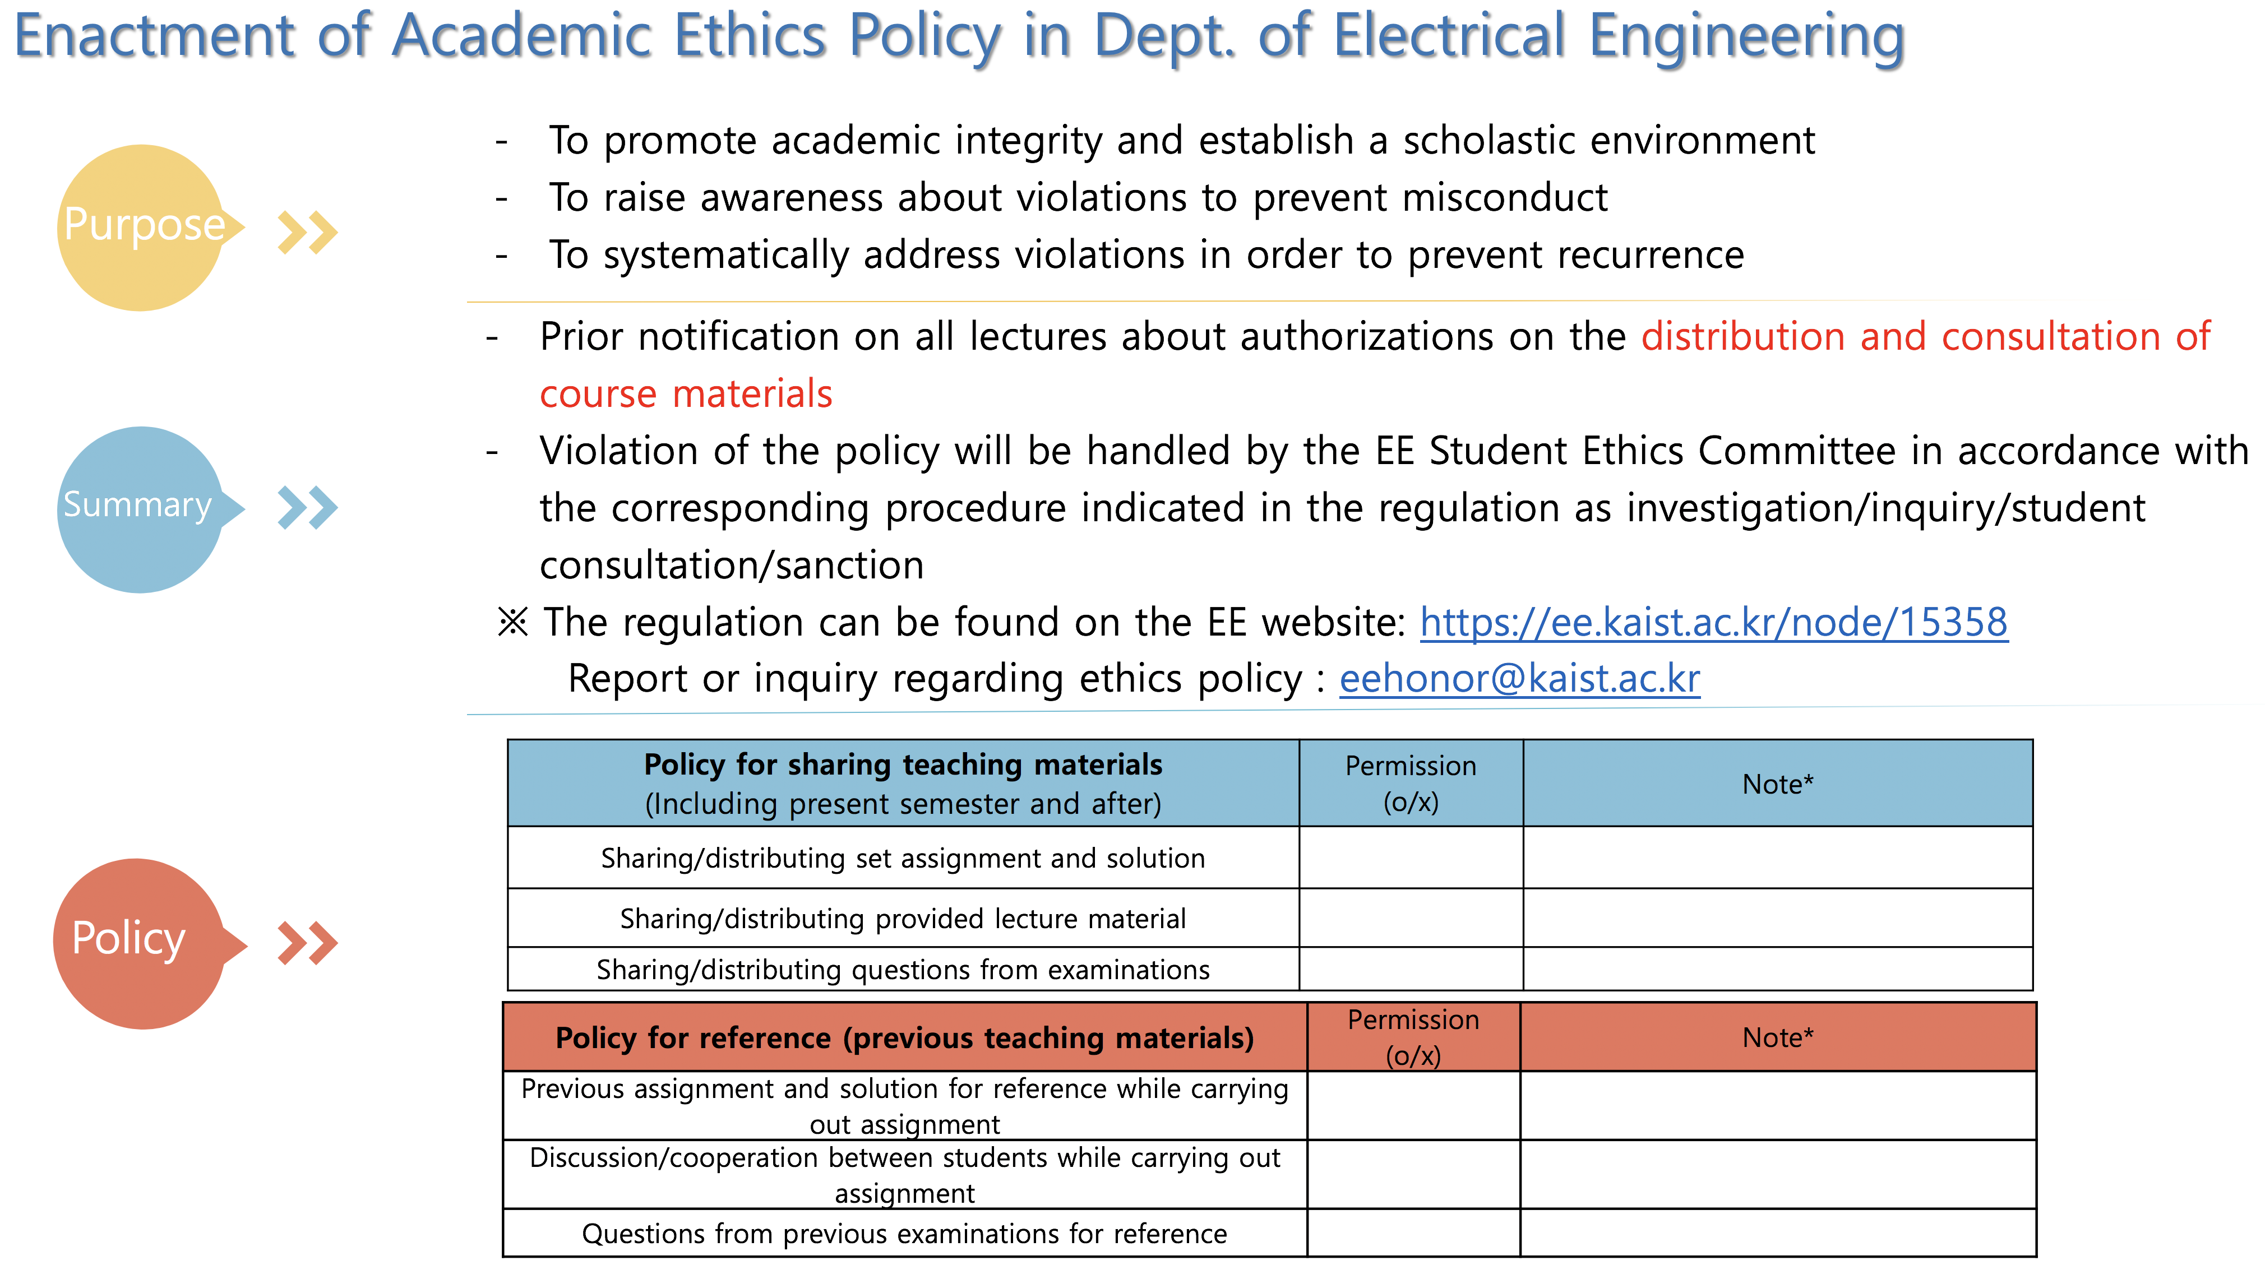

Slide 14
Summary (This Class)
수업자료 공유정책 (현 학기 중 공유/이후 학기 공유를 모두 포함) | 가능여부 (o/x) | 비고* (수업 별 특수 정책이 있는 경우 명시)
출제된 과제 및 과제풀이의 공유 및 배포 | x | Cannot give your homework to someone later
제공된 강의 자료의 공유 및 배포 | O
출제된 시험문제의 공유 및 배포 | O
이전 수업자료 참고정책 | 가능여부 (o/x) | 비고* (수업 별 특수 정책이 있는 경우 명시)
과제 수행 시 이전 기출 과제 및 과제풀이 참조 | X | No internet materials,
과제 수행 시 수강생 간의 토론/협업 | O, X | Only discussion, discussion based on the code copied to your computer not allowed
시험 준비 시, 이전 기출문제 자료 참조 | O

Slide 15
Summary (This Class)
Policy for sharing teaching materials (Including present semester and after) | Permission (o/x) | Note*
Sharing/distributing set assignment and solution | x | Cannot give your homework to someone later
Sharing/distributing provided lecture material | O
Sharing/distributing questions from examinations | O
Policy for reference (previous teaching materials) | Permission (o/x) | Note*
Previous assignment and solution for reference while carrying out assignment | X | No internet materials
Discussion/cooperation between students while carrying out assignment | O, X | Only discussion, discussion based on the code copied to your computer not allowed
Questions from previous examinations for reference | O

Slide 16
학업윤리 위반 사례 공유
위반행위 | 처분내용 | 발생 횟수 | 비고
과제물 표절 | 학부 내 징계 사회봉사 30시간 | 12
허용되지 않은 자료 제공 및 전달 | 학부 내 징계 사회봉사 15시간 | 9
부정행위 방조 및 허용되지 않은 자료 단순 열람 | 경고 (경고메일 발송) | 3
튜터의 윤리위반 | 학부 내 징계 사회봉사 30시간, | 2 | 튜터링 과정에서 튜티에게 부정행위를 권유 및 지원한 경우
시험부정행위 | 유기정학 2개월, 사회봉사활동 100시간 | 2 | 전기및전자공학부 과목에서 발생한 부정행위 EE학생 윤리규정에 따라 처분.
 | 학부 내 징계 사회봉사 60시간 | 1 | 타과 과목에서 발생한 부정행위, 과목 담당 교수가 학생 징계를 요청하지 않은 케이스
시험부정행위 (익명제보) | - | 1 | 진상조사/면담/심의를 진행하였으나, 제보내용 외 부정행위를 확정할 수 있는 근거가 없어 처분하지 않음.

Slide 17
Cases of Violation of Academic Ethics
Violation | Sanction | Number of Incidents | Note
Homework plagiarism | Individual sanction in the Department, 30 hours of social service | 12
Delivering unauthorized materials | Individual sanction in the Department, 15 hours of social service | 9
Aiding a violation or simple browsing through unauthorized materials | Letter of warning (via email) | 3
Ethical violation by a Tutor | Individual sanction in the Department, 30 hours of social service | 2 | Recommending and supporting an ethical violation to the Tutee during Tutoring time.
Violation during examinations | Defined suspension of 2 months, 100 hours of social service | 2 | Violation during a course in EE. Sanctions imposed as noted in the EE Student Ethics Policy.
 | Individual sanction in the Department, 60 hours of social service | 1 | Violation during a course in another Dept. Course professor did not request sanctions.
Violation during examinations (anonymous report) | - | 1 | No sanction can be imposed. Cause there’s no other actual evidence except for the anonymous report, despite investigation, interview and deliberation.

Slide 18
Recommendation
If you are not clear about whether what you do is cheating or not, please ask Prof. Yung Yi
Basically,
Don’t copy the code from the Internet
Don’t store other people’s code in your storage
Don’t discuss by looking at others’ code (even in the screen)
Highly likely to share codes
Remember
Zero Tolerance!

Slide 19
Announcement: First In-class Test
30 mins Exam on Sep. 5th(Wed)
About C++ lectures (the problems will be made mainly based on my lecture notes)
So, please watch and study them as soon as possible!

Slide 20
Announcement: First Programming Assignment
Will be Announced on Aug. 29th
Due on Sep. 19th
Practice about C++ programming
Not very difficult

Slide 21
Course Overview

Slide 22
Data Structures Definitions
Ways to organize and store data
Data Storages
Ways to access and manipulate the stored data.
Methods to access storages

Slide 23
Example (adjacent states)

Slide 24
Problem
Definition: adjacency: if two states share a boundary, the two states are adjacent.
Given a state X, print a state Z that is not adjacent to X, but is adjacent to a state Y adjacent to X.
for example,
Input: North Carolina
Output: Florida

Slide 25
Come up with Data Structures
Suppose you have only the following information
for each state x, the list of states that are adjacent to state x.
for example,
North Carolina : Georgia, south Carolina, Virginia, Tennessee.
How are you going to store this adjacency information to solve the problem efficiently?

Slide 26
Lessons
Different data structures lead to different ways to solve a given problem. (algorithms).
Different algorithms may give different efficiency (space and time).

Slide 27
Course outline
First Topic: How to measure the efficiency of an algorithm.
Each data structure has a different use and application. So we will also study….
Applications (problems), algorithms.
Their efficiency.

Slide 28
Course outline
Data Structures
Arrays
Stacks, Queues
List
Priority queues
Search Trees
Graphs
etc …

Slide 29

Stack
A container of objects that are inserted and removed according to the last-in-first-out (LIFO) principle.
Only the last (the most recently inserted) object can be removed.

Slide 30
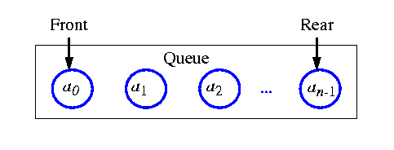
Queue
Differs from a stack in that its insertion and removal follows the first-in-first-out (FIFO) principle.
The element which has been in the queue the longest may be removed.

Slide 31
List
A collection of linearly arranged element (a linear order).
Provides methods for accessing, inserting, and removing arbitrary elements.
Notion of position, before and after.
Stacks and queues are a restricted form of a sequence.
Example,
A,B,C,D,E,F
a_1, a_2, a_3,…

Slide 32
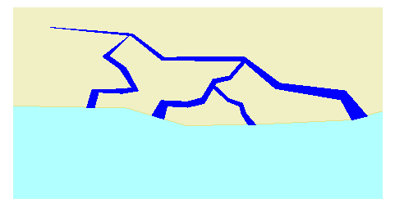
Tree
A collection of objects arranged in a hierarchical fashion.
E.g., organization of a corporation, a table of content, dos/unix file systems, family tree.
Notion of parents and children, root and leaves.

Slide 33
Priority queue
An abstract type for storing a collection of prioritized elements that supports arbitrary element insertion but support removal of elements only in order of priority.
Examples…..

Slide 34
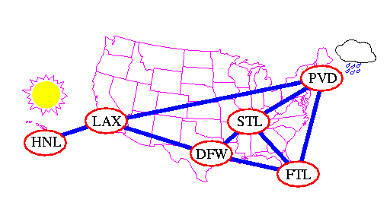
Graphs
Representing a way of connections or relationships between pairs of objects.

Slide 35
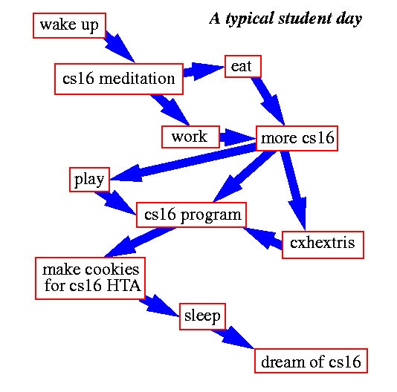
Graphs
Not only physical connectivity, but also logical relationship.

Slide 36
Algorithms and Applications
Every computer software uses some collections of data structures.
We will study algorithms to efficiently solve problems using various data structures.
Proof techniques for correctness or efficiency.

Slide 37
Questions?

Slide 38
Project 1: Linked List
Receiving Messages from a Packet Network
Network
Good morning
2-3 soon
1-2
1-1
2-2 you
2-3
1-2
2-1 See
2-1
2-1
See you soon
1-2 morning
1-1
2-2
1-1 Good
2-2
2-3

Slide 39
Project 2: Search Trees
Searching and Replacing Text in a Large File
Ex) Laboratory of network architecture design and analysis
design
and
network
analysis
architecture
laboratory
of
Search and replace the word ‘network’ to ‘world’

Slide 40
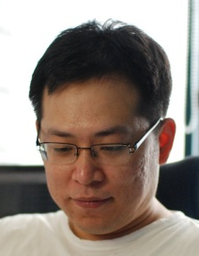
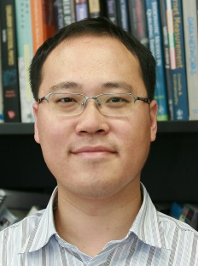
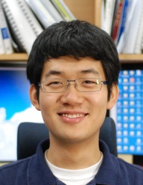
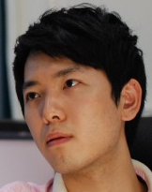
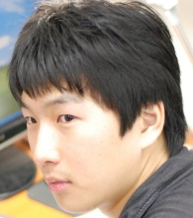
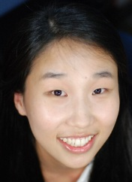
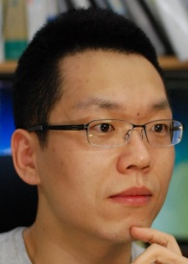
Project 3: Graphs
Relationships in a Social Network
SH
DG
SH and DG are friend, isn’t it?

